Slide 1
Studies on light propagation in DCM doped PVA waveguides embedded with randomly dispersed Silica particles
Under the guidance of Dr.S.N.B.Bhaktha, Dept. of Physics, Indian Institute of Physics, Kharagpur. W.Raja Vikram Bhatt-11PH20032

Slide 2
Outline of Presentation
Introduction to Random Lasers
Synthesis of surface waveguide of silica particles by Langmuir Blodgett Technique
Characterization by SEM
Photoluminescence studies
Acknowledgements

Slide 3
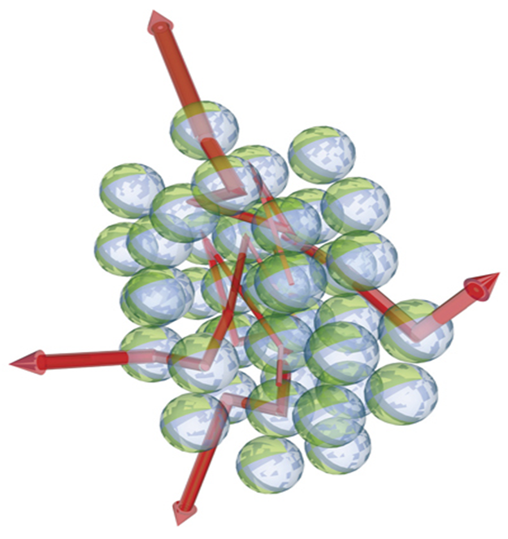
Random Lasers
Multiple scattering with gain.
Mirror less but not mode less.
Multiple scattering determines modes, frequency, bandwidth and lifetime.
Fig. Multiple light scattering with gain. A random collection of microspheres containing laser dye is excited (for example, by an external light source) to obtain population inversion. The microspheres then scatter light and amplify it in the process. The propagation of the light waves becomes that of an amplified random walk.

Slide 4
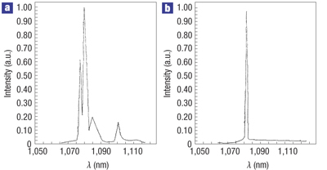
Fig. The emission spectrum of a solid random-laser material based on Neodinium- (Nd³⁺) doped lanthanum oxide (La₂O₃).
a)The fluorescence spectrum of the material below threshold. b)The material is above threshold and the spectrum narrows strongly.(Briskina and co workers). Markushev, V. M., Zolin, V. F. & Briskina, Ch. M. Powder laser. Zh. Prikl. Spektrosk. 45,847–850 (1986).

Slide 5
Random Lasing Materials
By using monodisperse spheres, a material in which the scattering at certain wavelengths is resonant with the sphere diameter can be obtained.
This leads to strong resonant scattering, which favors random laser modes at the specific wavelengths of the resonances. Hence, the emission bands of the random laser could be tuned this way by varying the particle diameter.
In this context we prepared colloidal photonic crystals.

Slide 6
Surface Pressure | No. of Samples Prepared | Volume of colloidal silica solution injected (micro litres)
9mN/m | 3 | 100
18mN/m | 3 | 150
27mN/m | 3 | 230
Silica particles are prepared by modified Stober method.
We used allyltrimethoxysilane as the surface functionalizing agent.
Substrates-Glass slides, Sub phase-Water
Precise control of film thickness
Experimental parameters | Values
Barrier Compression/Expansion Speed | 3cm/min
Upstroke/Down stroke Speed | 6mm/min

Slide 7
Scanning Electron Microscopy
The distribution of silica spheres on the substrate was measured by scanning electron microscope SEM observations are performed with ZEISS EVO 60 Analytical Scanning Electron Microscope with Oxford EDS Detector at 30kV.
The specimens were gold coated prior to the examination.

Slide 8
Fig. SEM images of film formed at 27mN/m which shows formation of single layer as expected short-range structural coherence and also formation aggregates.

Slide 9
Fig. SEM images of thin films made at 18mN/m which shows islands less densely packed.

Slide 10
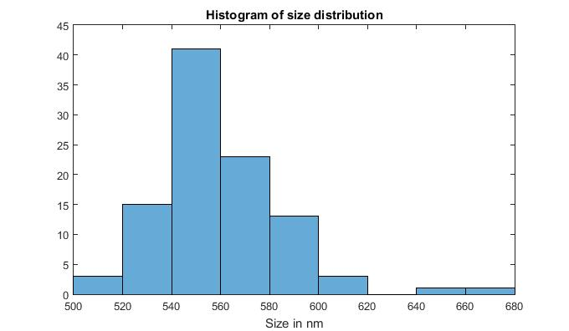
Particle size range(in nm) | Percentage of particles
500-520 | 3%
520-540 | 15%
540-560 | 41%
560-580 | 23%
580-600 | 13%
600-620 | 3%
640-680 | 2%
Fig. Distribution of particle size obtained from SEM images for sample size of 100 particles. Origin of size polydispersity is due to highly dependent on pH and temperature of the reaction.

Slide 11
Photoluminescence Studies
In order to study the dependence of packing density effect on emission properties, we fabricated three waveguides.
The dielectric waveguides were fabricated by coating random distributed silica spheres on a quartz substrate refractive index n=1.458 and then covered by a 2mM DCM(+methanol) doped poly vinyl alcohol (PVA) film refractive index n=1.50 in 1:3 ratio.
Another one without silica particles with DCM+PVA. The samples were optically pumped by the frequency doubled(532nm-second harmonic) output of a mode-locked Nd:YAG laser.

Slide 12
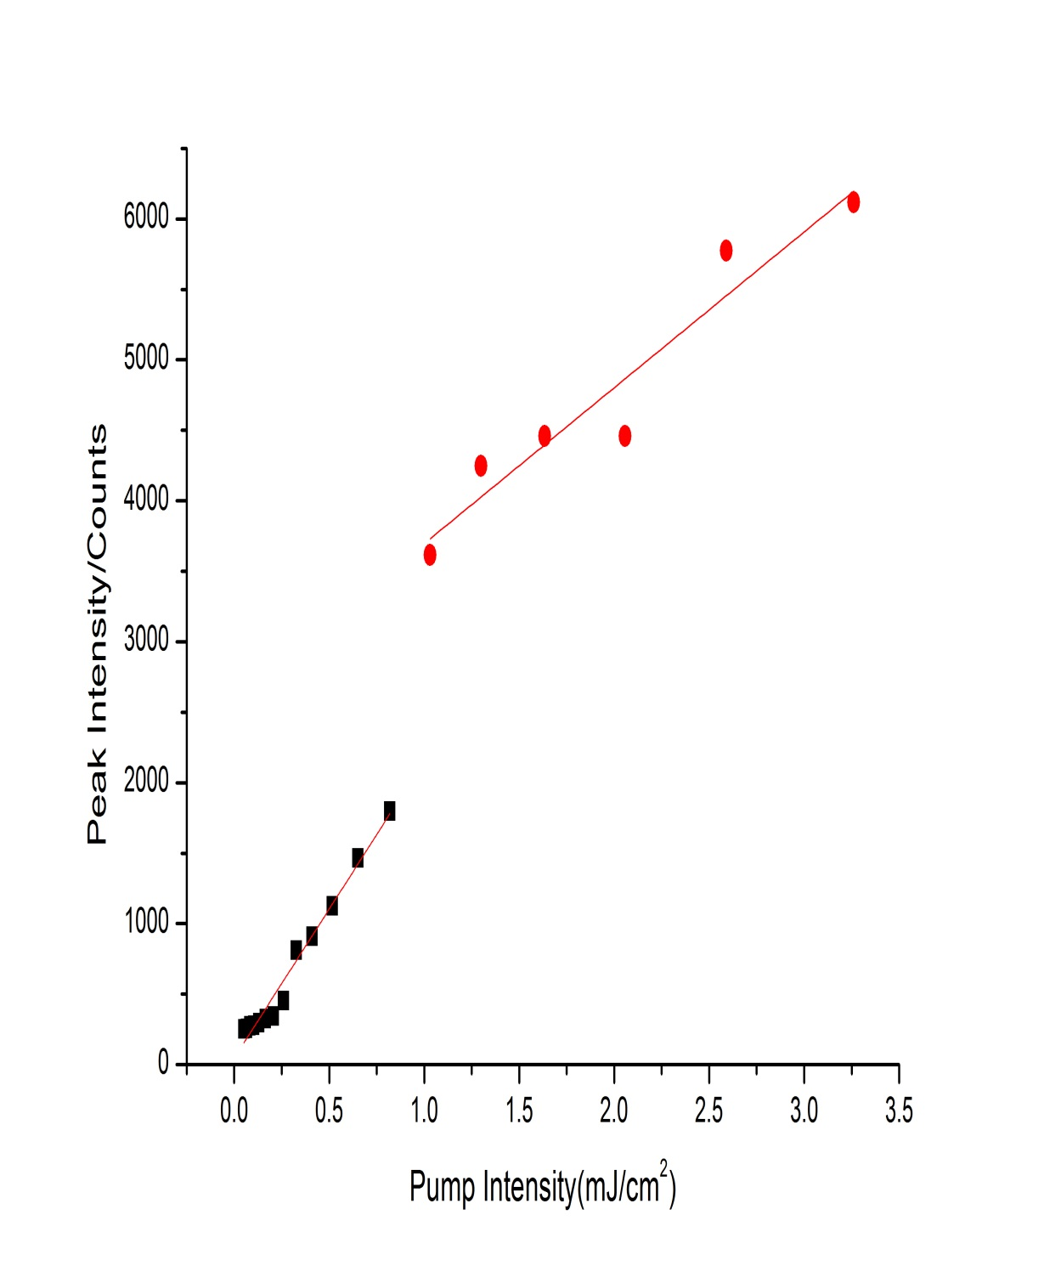
The RL threshold(0.079mJ) is considered to be the point for which there is a change in slope in the light-light curve.
The change in slope in the light-light curve at RL threshold is not very significant in these samples since in the incoherent regime the RL emission behaviour resembles that of amplified spontaneous emission, which is known to present smooth transitions at threshold.

Slide 13
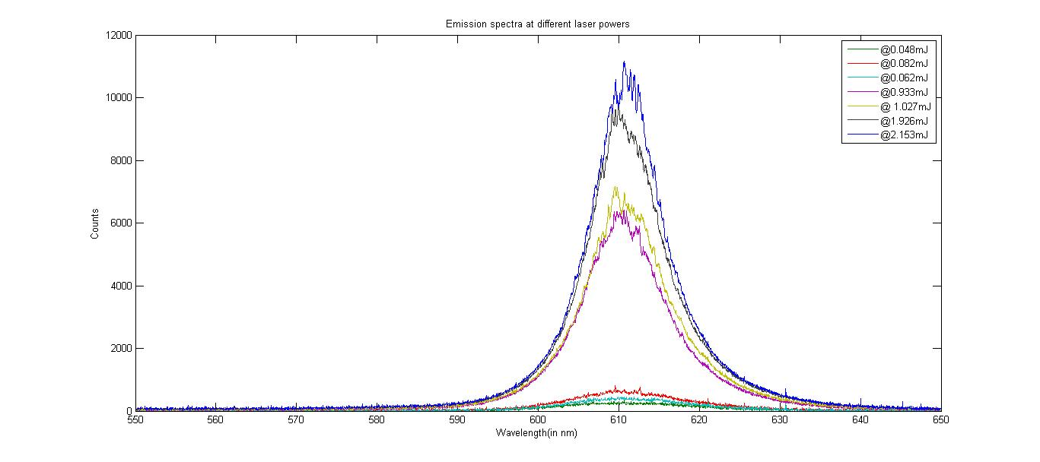
Fig. Emission spectra for sample-I at different power levels depicting above
threshold value(0.079mJ/cm) the peak narrows down strongly. Line width of the peak at highest intensity is 75nm.Emission occurring in coherent regime.

Slide 14
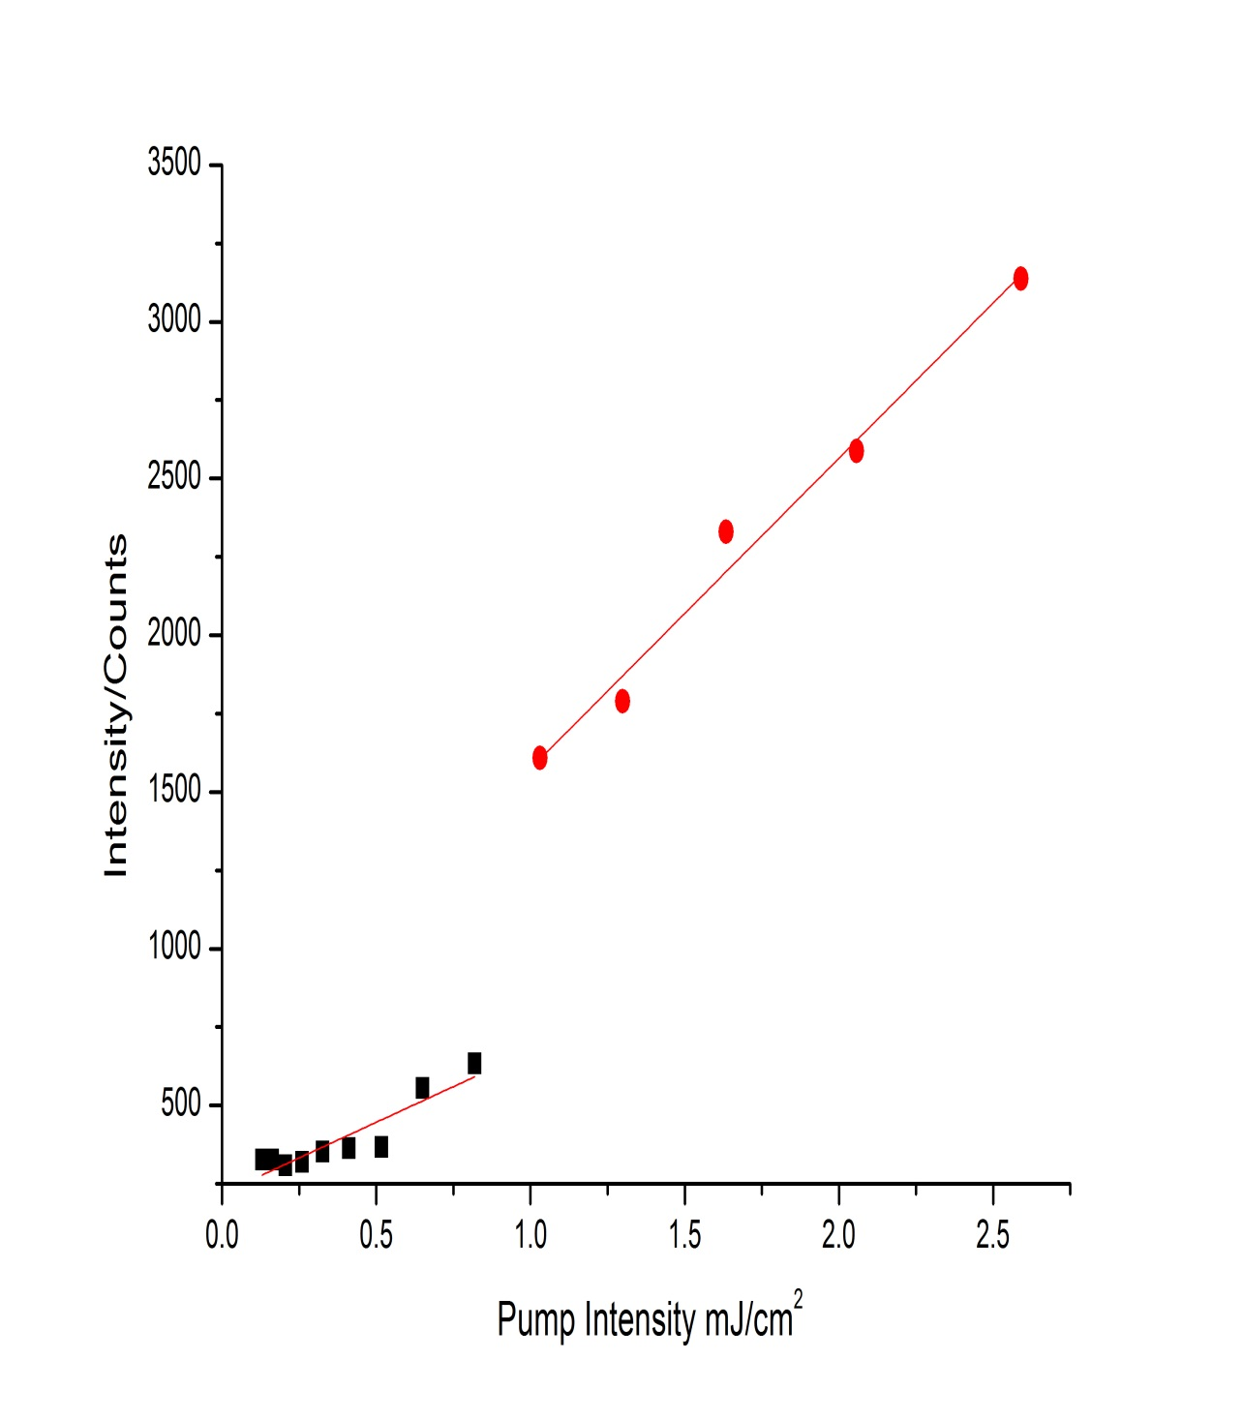
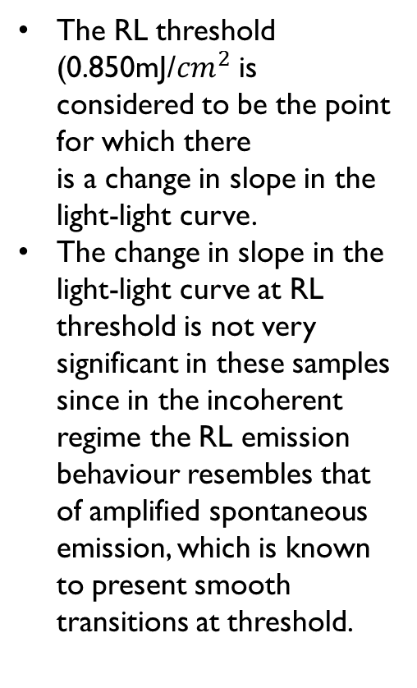
The RL threshold (0.850mJ/${cm}^{2}$ is considered to be the point for which there is a change in slope in the light-light curve.
The change in slope in the light-light curve at RL threshold is not very significant in these samples since in the incoherent regime the RL emission behaviour resembles that of amplified spontaneous emission, which is known to present smooth transitions at threshold.

Slide 15
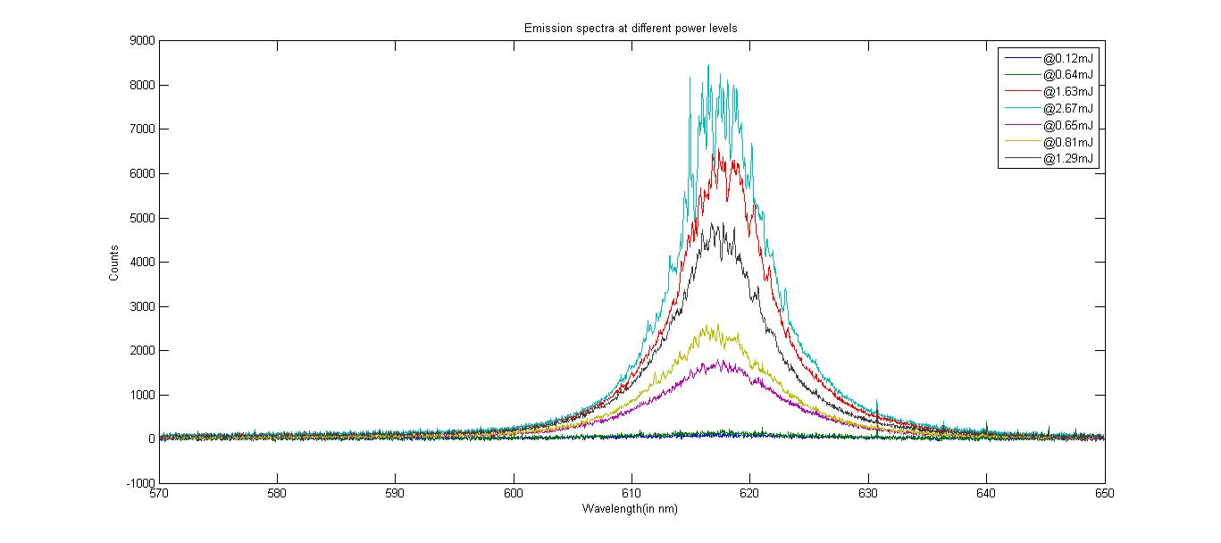
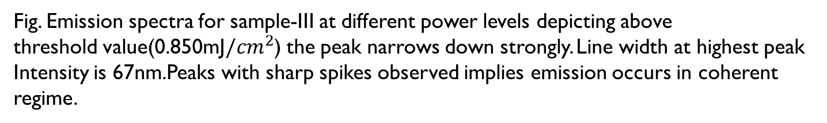
Fig. Emission spectra for sample-III at different power levels depicting above threshold value(0.850mJ${/cm}^{2}$) the peak narrows down strongly. Line width at highest peak
Intensity is 67nm.Peaks with sharp spikes observed implies emission occurs in coherent regime.

Slide 16
Acknowledgements
I am highly indebted to Dr.S.N.B.Bhakta for his guidance and constant supervision as well as for providing necessary information regarding the project.
I am grateful for Mr.Anirban Sarkar, Mr.Subhratha Ghosh, Ms.Pratyusha Das and Ms.Ojha Subhashree for giving me such attention and time.

Slide 17
Thank you!

